Slide 1
Distributed Computing A Model of Distributed Computations
Dr. Barsha Mitra
CSIS Dept, BITS Pilani, Hyderabad Campus

Slide 2
Preliminaries
distributed system consists of a set of processors
connected by a communication network
communication delay is finite but unpredictable
processors do not share a common global memory
asynchronous message passing
no common physical global clock
communication medium may deliver messages out of order
messages may be lost, garbled, or duplicated due to timeout and retransmission
processors may fail, and communication links may go down
Course ID: SS ZG526, Title: Distributed Computing

Slide 3
A Distributed Program
C_{ij} : channel from process p_{i} to process p_{j}
m_{ij}: message sent by p_{i} to p_{j}
Global state of a distributed computation consists of
states of the processes
states of the communication channels
State of a process is characterized by its local memory state
Set of messages in transit in the channel characterizes state of channel
Occurrence of events
changes respective processes' states
changes channels' states
causes transition in global system state
Course ID: SS ZG526, Title: Distributed Computing

Slide 4
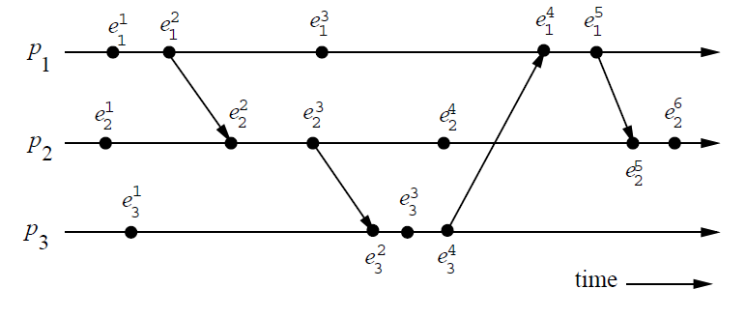
A Model of Distributed Executions
Course ID: SS ZG526, Title: Distributed Computing

Slide 5
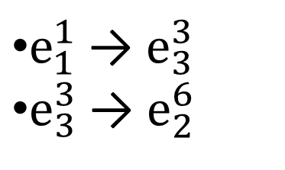
A Model of Distributed Executions
Causal Precedence/Dependency or Happens Before Relation
Relation → denotes flow of information in a distributed computation
e_{i} → e_{j} implies that all the information available at e_{i} is accessible at e_{j}
path
Course ID: SS ZG526, Title: Distributed Computing

Slide 6
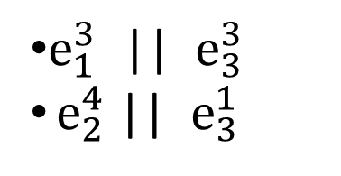
A Model of Distributed Executions
Concurrent Events
For any two events e_{i} and e_{j} , if e_{i} e_{j} and e_{j} e_{i} , then events e_{i} and e_{j} are concurrent (denoted as e_{i} || e_{j})
non-transitive
Course ID: SS ZG526, Title: Distributed Computing

Slide 7
Models of Communication Networks
FIFO model:
each channel acts as a first-in first-out message queue
message ordering is preserved by channel
Non-FIFO model
channel acts like a set
sender process adds messages to channel
receiver process removes messages from it
Course ID: SS ZG526, Title: Distributed Computing

Slide 8
Models of Communication Networks
Causal ordering model is based on Lamport’s “happens before” relation
A system supporting causal ordering model satisfies :
CO: for m_{ij} and m_{kj} , if send(m_{ij} ) → send(m_{kj} ),
then rec(m_{ij} ) → rec(m_{kj} )
Causally ordered delivery of messages implies FIFO message delivery
CO ⊂ FIFO ⊂ Non-FIFO
Course ID: SS ZG526, Title: Distributed Computing

Slide 9
Global State of a Distributed System
LS_{i}^{x}: state of process p_{i} after the occurrence of e_{i}^{x} and before e_{i}^{x+1}
SC_{ij} : state of channel C_{ij}
Consistent Global State
a state will be meaningful and consistent provided every message that is recorded as received is also recorded as sent
for all m_{ij}, send(m_{ij}) ∉ LS_{i}^{x} ⇒ m_{ij} ∉ SC_{ij} ∧ rec(m_{ij}) ∉ LS_{j}^{y}
Course ID: SS ZG526, Title: Distributed Computing

Slide 10
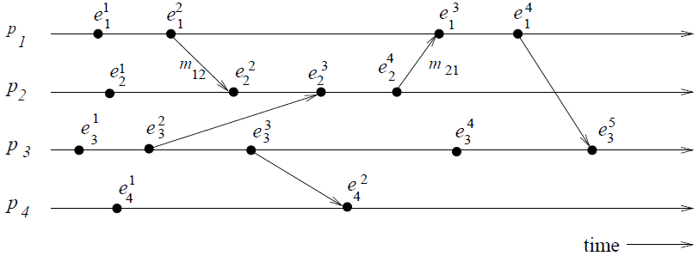
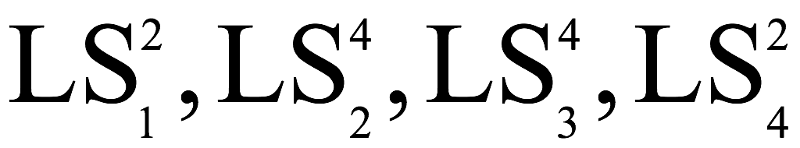
Global State of a Distributed System
GS₂ = { }
is consistent
Reason: all channels are empty except C₂₁ which contains m₂₁
Course ID: SS ZG526, Title: Distributed Computing

Slide 11
Cuts of a Distributed Computation
Zigzag line joining one arbitrary point on each process line
Set of events in distributed computation is partitioned into
PAST: contains all events to the left of the cut
FUTURE: contains all events to the right of the cut
Every cut corresponds to a global state
Every global state can be graphically represented as a cut
Course ID: SS ZG526, Title: Distributed Computing

Slide 12
Cuts of a Distributed Computation
Consistent cut: every message received in the PAST of the cut was sent in the PAST of that cut
All messages that cross the cut from the PAST to the FUTURE are in transit
Inconsistent cut: if a message crosses the cut from the FUTURE to the PAST
Course ID: SS ZG526, Title: Distributed Computing

Slide 13
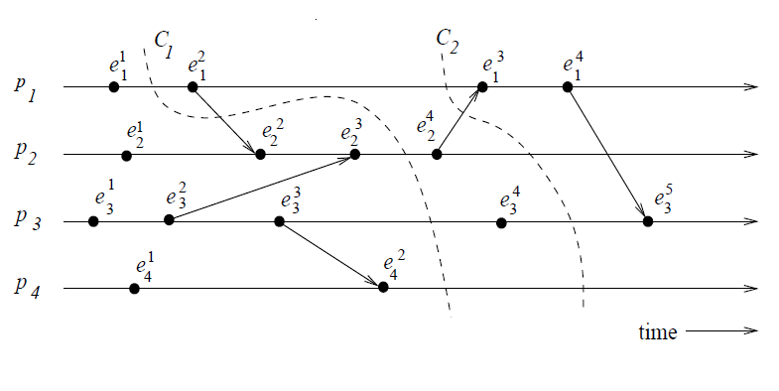
Cuts of a Distributed Computation
C₂ → consistent cut
C₁ → inconsistent cut
Course ID: SS ZG526, Title: Distributed Computing

Slide 14
Reference
Ajay D. Kshemkalyani, and Mukesh Singhal, Chapter 2, “Distributed Computing: Principles, Algorithms, and Systems”, Cambridge University Press, 2008.
Course ID: SS ZG526, Title: Distributed Computing

Slide 15
Thank You
Course ID: SS ZG526, Title: Distributed Computing

